Slide 1
v
Exeter Scholars Student Conference
Notes:
Firstly I’d like to welcome you all to the Great Hall here at the University of Exeter for our Exeter Scholars Student Conference today. Thank you all for coming- we understand how challenging this might have been today with rail strikes happening, but we’re so pleased to see so many of you here in person! This is actually the first time we’ve been able to run this Conference in person here on campus in nearly 3 years due to covid, so it’s so exciting to have you all here with us today – thank you for coming!
I’ll take a few moments to introduce myself and the team who are behind the Exeter Scholars programme and today’s conference
I’m Hayley Stentiford, I’m responsible for delivery of the Year 12 programme…
You’ll also be hearing from Bryanna Kilroy who helps ensure the programme runs smoothly and who is the first point of contact for your student enquiries. Melissa Ruddock is also in the room as the over-arching Exeter Scholars Manager and she will be available to talk to later on and throughout the day and will be leading the Guest Q&A session for parent/carers this afternoon.
-Behind the scenes there’s also a large team of academic college staff who help to run the subject strand sessions both here in Exeter and in Penryn, many of these you’ll get to meet later today – so it really is a big team effort.
-Now that you’ve joined the Exeter Scholars programme, you have become part of that community and you’ll hear a lot more about what this means throughout the day.

Slide 2
Exeter Scholars Student Conference
Welcome!
House keeping
Student pack & lanyard
Plan for today
Groupings for the day
Answer your questions/concerns
Notes:
Fire – not expecting fire drills today. If you hear the fire alarm, exit via the nearest fire exit – doors at front and back of the Hall – Don’t use lifts – accessibility requirements, exit via back doors and you will lead out to the back car park. Front doors lead back to the piazza at the front of the Great Hall.
Mobile phones
Run through contents of tote bag (useful info for today’s conference and to introduce you to the programme more broadly):
Programme for today
Exhibition floor plan/key
Evaluation form for later…
Flag group one and group two on coloured lanyards
The aim of today is to help you get a greater understanding about what Exeter Scholars will mean for you and to meet your fellow participants and subject staff/team members that you will be working with over the next 2 years
Take the opportunity to make sure any questions or concerns you have are addressed – we will have Q&A opportunities and you’ll have opportunities to ask anything you like throughout the day, however, don’t try to do it all! Use today to get a feel for the programme and then when you go home have a closer look at the info in your packs and check out the website for further info

Slide 3
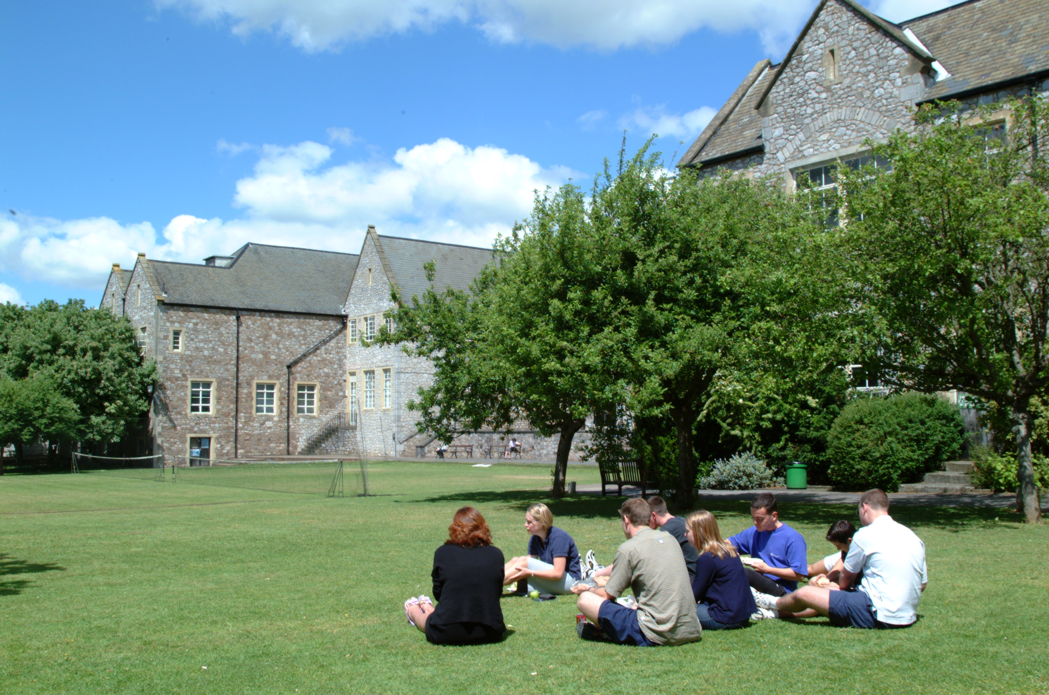
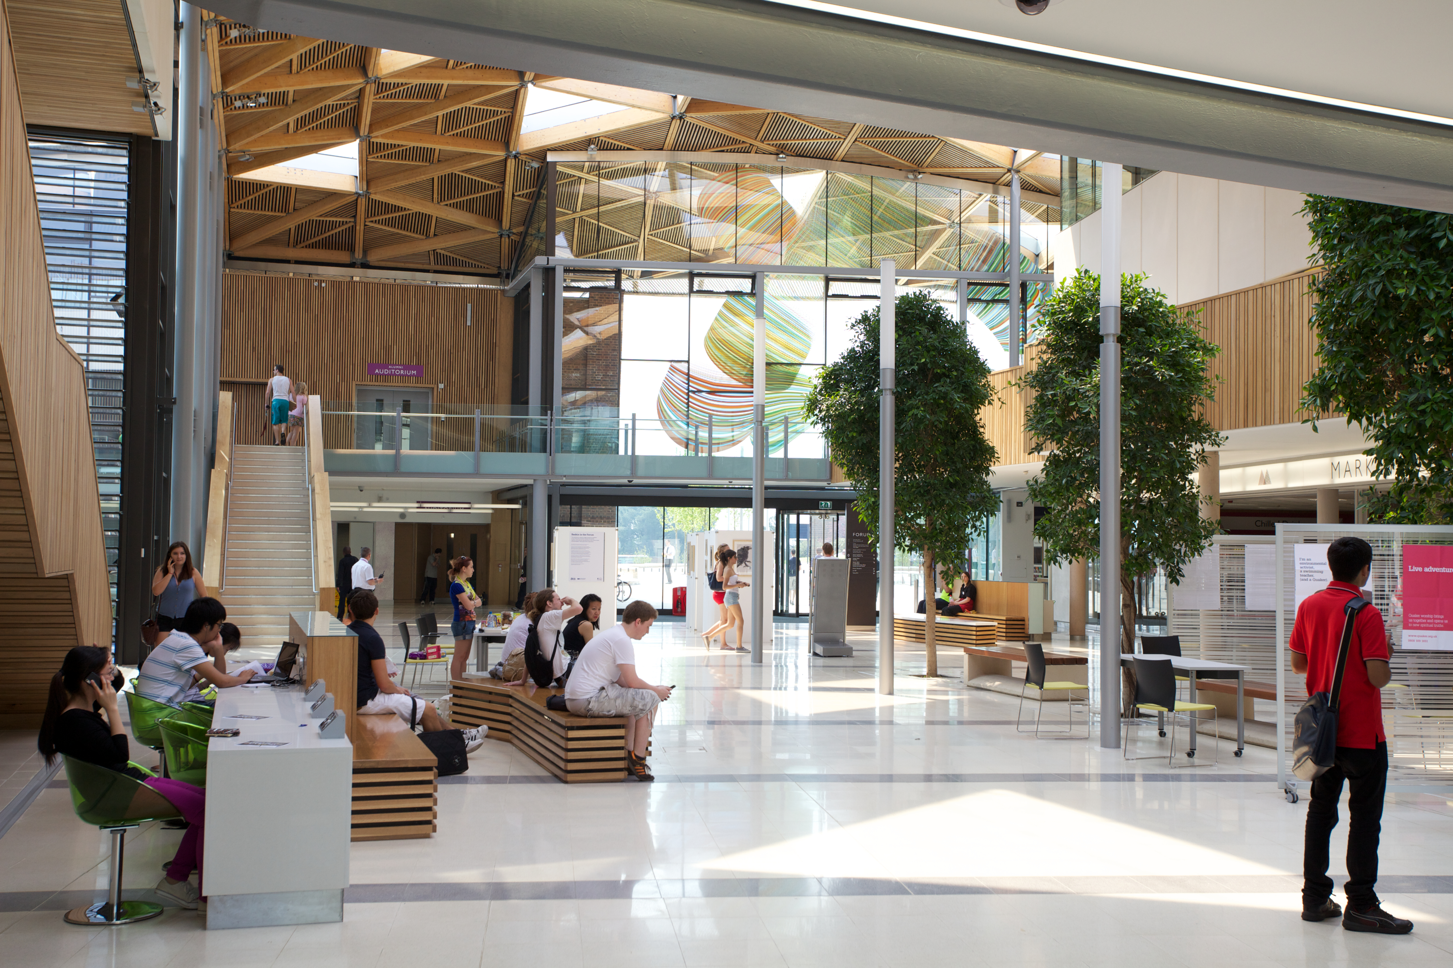
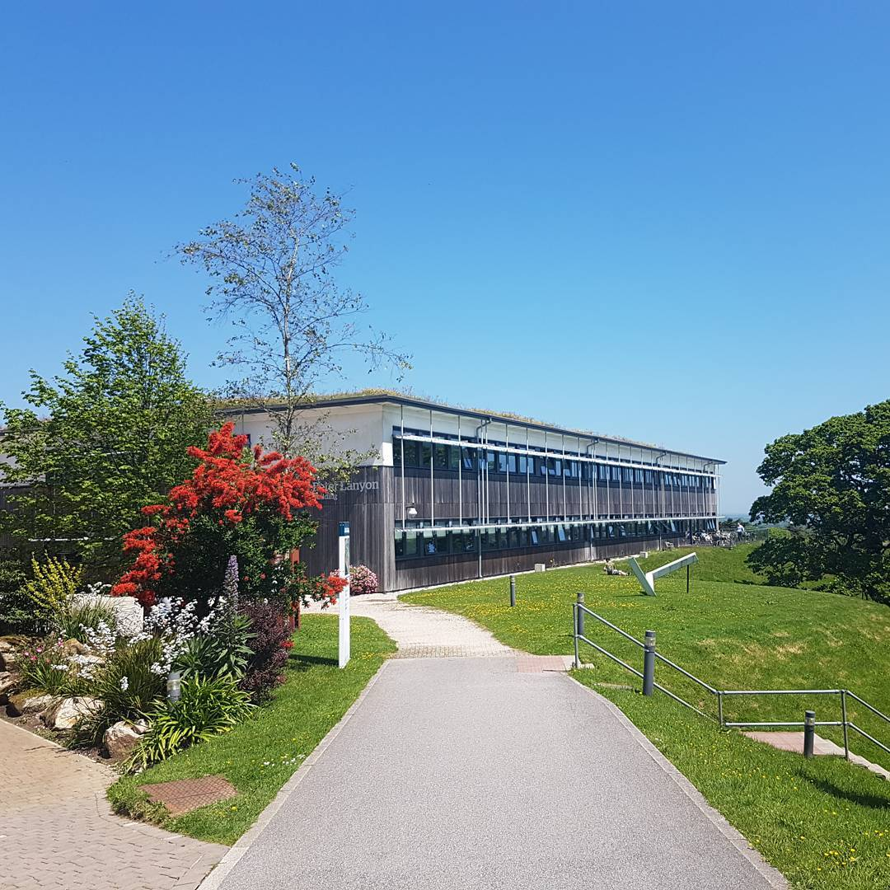
Our Campuses
Notes:
“Before we start today’s activities I would like to tell you a little bit about The University of Exeter.
We are a medium sized university with approximately 27,000 students who come from all across the world to study here. To put that in perspective some of the larger universities, such as Manchester, have upward of 39,000 full time students whilst some of the smaller universities, such as Falmouth University may have just over 3,000 full time students.
You may have heard of our university before as we are a member of the Russell Group which means that a lot of our academics and students are involved in research to try and understand the world around us. This could involve them trying to find cures for illnesses such as diabetes, working on covid vaccines more recently, or discovering new planets outside of our solar system.” This means that we are among one of the top universities in the UK for teaching and research.
Our university is comprised of three campuses. This one, the Streatham Campus, which you will see more of on your campus tour, is the largest of the three. The second campus, St Luke’s, is also in Exeter and is located across the other side of the city centre, this is where our Medics, Sports Scientists and future teachers study. It is about a 25 minute walk away from the Streatham campus.
Our third campus is the Penryn Campus, which is located in Cornwall we share that site with Falmouth University. Some of the subjects we teach there are the same as the ones we teach here in Exeter, like Geography and Biosciences, however unlike at school where that would mean the content is pretty much the same, they are actually very different courses.” Use Exeter Scholars to get a feel for which courses you may be interested in studying at university and get familiar with looking into course modules and thinking about what you’ll enjoy studying most.

Slide 4
Exeter Scholars
What is the Exeter Scholars programme? Watch this video to find out: https://youtu.be/pPBqWck_b4A
Notes:
-Play the new Scholars promo video.
-You are all now on our Year 12 SW pathway of the programme and joining a large community of Exeter Scholars participants.
I really like the line towards the end of the video that describes Exeter Scholars as a ’trail run’ and a chance to find out more about university and whether it’s the right option for you. Also Conner mentions that the programme allows you to try out things you maybe hadn’t considered before – pushes you out of comfort zone and allows you to meet new people.

Slide 5
A Focus on Wellbeing
Notes:
-We take wellbeing very seriously at Exeter Scholars and this will be a running theme throughout the programme.
-By wellbeing we mean all those things you need to do to keep yourself healthy in mind, body and spirit. This can be anything from learning tips for stress and time management around exam times, to learning how to be resilient and overcome challenges. Of course we can also support you with any specific wellbeing requirements you may have - such as mental health difficulties, learning requirements and accessibility requirements, but we want to support a holistic approach and encourage all Exeter Scholars participants to consider and look after their own wellbeing.
-INDEPENDENCE – we encourage this from day one of your engagement with the programme – travelling to sessions, emailing us proactively, asking questions, engaging with sessions/additional events, etc.
-Wellbeing will be addressed throughout the programme as you are all entering a time of transition – currently you’re learning to adapt to A Level or equivalent studies and, looking forward, you will be preparing for the transition to HE or to work. This can be a really challenging but exciting time and we want to support you in learning to take personal responsibility for your own wellbeing and we want you to know what support is available. More info on this to follow, including the personalised support that we can offer participants through our PEPs - from Bryanna later…

Slide 6
Becoming a University of Exeter Scholar:
Benefits Packages
Notes:
Please do go to the Exeter Scholars website after this event and look over the Exeter Scholars benefits packages. You’ll see that there are two benefits packages, one relates to being an Exeter Scholar and one to becoming a Senior Scholar - which you will all have the opportunity to become in Year 13… further info will be provided throughout the course of the year so don’t worry about this now but take some time to look at the benefits available to you in your own time.
Before the end of Year 13 you will have the opportunity to take advantage of the following:
A Year 12 Student Conference – Today!
A programme of regular, subject specific activity sessions at one or more University of Exeter campus
Access to our bespoke online learning platform, Brightspace and the opportunity to talk live to Student Ambassadors on TAP!
A UCAS preparation workshop and interview skills Prep Day
UCAS personal statement checking service – all year round
Careers Insight Week live panel events
Successful completion of the programme also earns you a reduction in entry requirements for all UoE undergraduate courses! No exemptions

Slide 7
Effective Engagement
Developing independence
Taking time out of school
Keeping up to date
Ways to catch up
Reflective learning
Notes:
-The programme is designed to help you develop independence and get a real taster of what it’s like to be a uni student! We encourage you to travel to subject sessions/ different campuses independently – meet up with new friends and travel down together. We reimburse the cost, but you plan! Time management, independence, communication skills developed!
-You will have to take some time out of school to attend some of your subject sessions. To do this, prepare in advance, it is your responsibility to authorise your absences and give teachers notice, but of course we will verify your participation in Exeter Scholars so that your teachers are aware that you are on the programme.
-Use the Exeter Scholars website to check the dates of subject sessions – there should be a balance of sessions across term time and holidays. Find out more about these and the relevant dates in your introductory subject sessions this afternoon
-To keep up to date we will send you regular electronic programme updates and other communications via email. These contain info about any forthcoming events, timely news, hints and tips, etc. so please do read these. Also check the website regularly and please do inform us if you change address/email so that we can contact you.
-If you have to miss sessions there are other ways to make up the time so don’t worry – a variety of events (virtual and in-person), campus tours, Open Days etc. More info will be provided – don’t worry about this.
-Reflective learning - we want to help you to become reflective learners and to think about how your Exeter Scholars experience and subject sessions can help you make informed decisions about your future. Developing key transferrable skills such as time management, team working, independence as well as these reflective skills will help you not only in your current studies, but also as you transition on to HE or a future career.

Slide 8
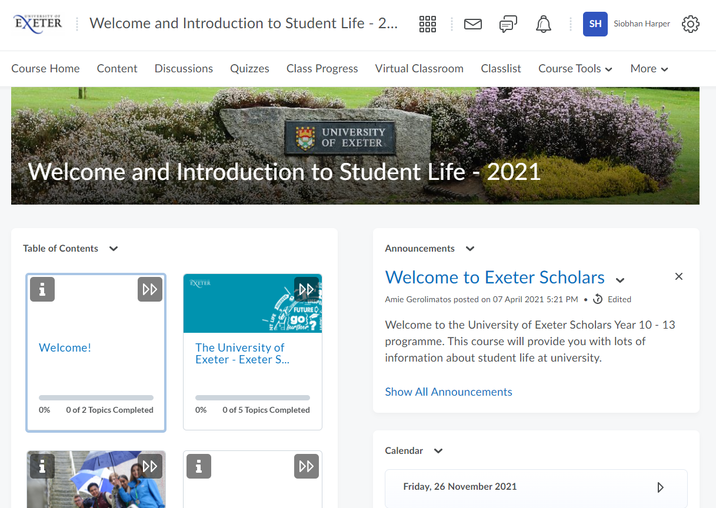
Online Support: Brightspace
Notes:
We now offer all Exeter Scholars participants a truly blended approach to accessing the programme and we have invested in a bespoke online learning platform, Brightspcae. You will all receive your persnalised login to Brightspace in the new year – here you will be able to access additional resources relating to your subject strand. You can take part in interactive activities such as quizzes and discussion forums, allowing you to talk to other participants on your subject strand as well as to your academic course coordinators.

Slide 9
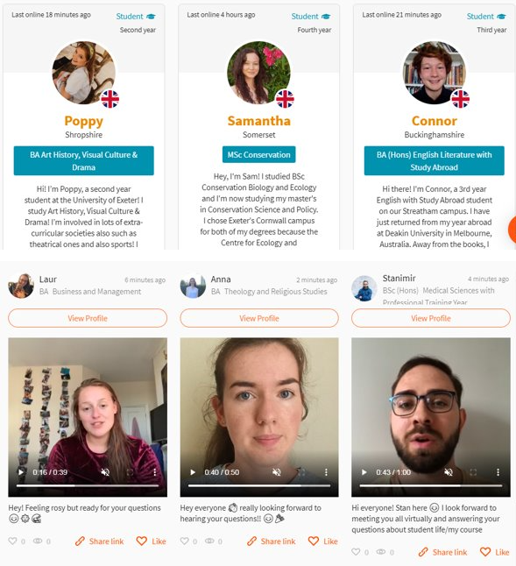
The
Ambassador Platform
(TAP)
Notes:
We also invested in an additional online platform, TAP which offers you the opportunity to talk regularly and safely to our SAs about topics that are relevant to you and to get your questions answered. You will be able to access this though your Brightspace login
Social media style content regularly produced for you to engage with and enjoy – looks a bit like a live Instagram feed! It’s really user-friendly.
You’ll be invited to use TAP to talk to SAs about topics such as student life, budgeting, societies, social life, choosing the right course, student accommodation, settling in, and much more!
More information on this to follow in the new year….

Slide 10
Exeter Scholars Alumni
“The Exeter Scholars experience has made me feel less anxious about the transition to university. It has helped me understand what university life will be like and has really increased my confidence in travelling alone, speaking to people I don't know and working in a university-based environment. This experience has been worthwhile and I have really enjoyed it.”
Natalia, Classics & Ancient History subject activity strand
Notes:
-I wanted to include these real student quotes from students who completed the programme to underline how valuable it can be if you fully engage!
-Skills developed to help with transition to HE/general life skills or skills for work!

Slide 11
Exeter Scholars Alumni
“Exeter Scholars has helped me in so many ways. First of all, it helped me to decide what I finally wanted to do at university. Not only that, but it has helped me develop skills such as time management, team working and confidence. Finally, it helped me take initiative over my future. By stepping out of my comfort zone, Exeter Scholars has allowed me to gain an unforgettable experience and a true insight into university life.”
Joseph, Medical Professions subject activity strand
Notes:
-Underline that ‘increased confidence’ is mentioned in both student quotes. This really is a take-home message.
-Most of our students say that the programme really helps to increase their confidence and preparedness in feeling ready to progress on to HE.

Slide 12
Exeter Scholars Alumni
‘Managing the transition to sixth form’
‘Advice I would give to new participants’
Notes:
-I’d now like to introduce some of our Exeter Scholars alumni.
-These students all completed the programme with us and are now successfully enrolled on different courses as undergraduate students here at the UoE!
-They’re going to talk to you about their personal Exeter Scholars experiences and how they managed the transition to sixth form studies.

Slide 13
Subject Exhibition
Notes:
(3 mins)
As you will see on your programme, the Subject Exhibition will be happening from 12pm today in the Terrace, which is just opposite this room.
The Subject Exhibition will give you a chance to find out more about some of the courses and subject areas that we offer at the University of Exeter, as well as an opportunity to find out more about what life is like at university. I hope that you’ll be able to find information here that will reassure you about anything you’re worried about, but also excite you for the possibilities of other things that you can get out of university.
You have a floor plan of the Subject Exhibition and a list of what subject strands are represented where in your tote bags. Each stand is going to be managed by Student Ambassadors and members of staff from the University, who should be able to answer your questions. The staff manning the subject related stands are subject specialists who will be able to answer any questions you may have about what you’ll be doing as part of your progression to that subject, and what it would be like to study that subject at university. There are also stands that focus on Student Finance, Accommodation, and Student Social Life if you’d like to find out more about any of these topics.
The Exeter Scholars alumni, who we’re going to hear more from shortly, will also be at the exhibition, so please do feel free to ask them any questions when you see them – I’m sure they will be happy to share their experiences of the programme and give their top tips! Additionally, we have our colleague Melissa manning a stand specifically for the Exeter Scholars programme. Melissa is here to answer any questions you may have about the Exeter Scholars programme specifically – from logistics, to benefits, to practical arrangements. And she is also leading the Guest Q&A talk this afternoon, so parents and carers will also have the opportunity to ask lots of questions then.
A number of you will have got a place on your second or third choice of subject activity strand. Please remember that you will still get all of the programme benefits – including the reduced offer for ANY University of Exeter course - regardless of which subject strand you were allocated. So, please do take this opportunity to speak to the subject staff for your first choice if this applies to you! And this goes for all of you – if you’re not sure what subject you want to study at university, or whether a degree is the right way for you to pursue a subject that you’re interested in, or you got your first choice but you’re desperate to know more – now’s your chance to ask questions and get some answers! Even if you just have a passing interest, every question is welcome.
So hopefully you will have gaged that the main thing the Subject Exhibition is here for is to give you the opportunity to ask questions, so please do use this opportunity to have a chat and learn more, but if you do leave today and think of another question you’d like answered, please do drop us an email at exeterscholars@exeter.ac.uk and we can help!

Slide 14
Personal Engagement Plans
Offered to participants who require any kind of support in order to engage with the programme
Personal circumstances, academic support needs, health or medical requirements, visual impairments, stress or anxiety, concerns about online access for any virtual programme components, or anything else at all
If you requested this, we will contact you after the Student Conference to discuss your particular support requirements
If you did not request this but would now like one, please email us: exeterscholars@exeter.ac.uk
Notes:
(1 min)
As Hayley has already mentioned, we take wellbeing very seriously at Exeter Scholars, and this will be a running theme throughout the programme.
An important part of the support that we offer during your time on Exeter Scholars are our Personal Engagement Plans. When you filled out your application form, you might remember there was a question on the form about whether you’d like to be contacted about discussing a Personal Engagement Plan. If you ticked yes, we will be in contact after the Student Conference, and before your subject sessions start, to discuss your support requirements and how we might be able to help you feel more comfortable and supported on the programme. This might be similar support to what you might receive in school, but it is important for us to have this discussion with you to make sure everyone is clear about the support we can give you whilst you are on the programme. If you don’t think you requested to be contacted about a Personal Engagement Plan, but you would now like one, please do send us an email.

Slide 15

Exeter Scholars: Parent & Carer Information
Notes:
(1 min)
We think it’s really important to include participants’ parents and carers in the programme, to keep them informed and involved as you progress throughout Exeter Scholars - after all, it’s a new programme for your parents and carers too! Parents and carers are always welcome to get in touch with us and we are always happy to hear from you all.
We also have a parent and carer information section on our website, including a frequently asked questions page which details all of the typical questions that we get asked by parents and carers. We hope that it’s pretty comprehensive, but we are always happy to add further information to it should it be needed. If your parent or carer is not with you today, please do make them aware of this webpage and let them know that they are welcome to drop us an email any time.
Of course, you also have the opportunity to find out more and ask questions in the Parent and Carers Guest Q&A talk this afternoon which is being run by Melissa and one of our Student Ambassadors – please do take up this opportunity.

Slide 16

Exeter Scholars Travel Expenses Claim Form
Notes:
(3 mins)
So, now I’ll talk briefly about travel and how to get your travel costs reimbursed!
It is your responsibility to arrange your travel to and from the subject activity sessions – whether this is driving, getting a lift, getting public transport, or sharing the journey with a friend. Arranging your travel is a great way of learning independence, so we would suggest trying to do this yourself if possible, however we understand that this will not be the case for everybody.
You will hopefully already know that travel costs are covered for all of the compulsory elements of the programme – so that’s including today, and all of your subject activity sessions. We reimburse both mileage and travel by public transport; however, if you travelled by public transport, then we can only reimburse the students’ travel, and not that of any guest. For travel by public transport, we will require evidence of your journey – whether that’s a used ticket, a receipt, or anything that includes the price that you paid for the journey. For travel by car, we don’t need your fuel receipts; we will calculate the mileage based on the journey you took.
For claiming today’s travel and all subsequent subject activity sessions, we ask that you complete the form found on the ‘Travel Bursary’ section of our website. To find this page, go to our Exeter Scholars site, click on ‘current participants’ and think click on ‘travel bursary’.
From here, you will need to download the form, complete it electronically, and then return it to us via email, with any required evidence attached. All of the information for how to complete the form can be found on this page of the website, but we are of course happy to answer any questions about this at any time. We will then process your travel claim for payment. We tend to process travel claims once a week, and it can then take around two weeks or a little longer for all the finance processes to go through and for the money to reach you.
We do encourage you to fill in your travel claim form electronically and not send paper forms to us – for reasons of both sustainability and practicality – but we understand that internet access might not be possible for everyone. If this is the case for you, please come and let us know, and we can arrange an alternative for you.
It is completely up to your when you want to send in your travel claims – you can either do it as you go and send us them after each subject session, or you can wait a while and do them in bulk, whatever is easiest! Again, if you have any questions about travel claims, just send us an email at exeterscholars and we can help.

Slide 17
Exeter Scholars Alumni
‘My Exeter Scholars experience’
‘Advice I would give to new participants’
Notes:
Now let’s welcome back the Exeter Scholars alumni to talk about their own Exeter Scholars experience and give their advice on getting the most out of the programme…

Slide 18
Any Questions?
Notes:
-Introduce Q&A session and use of catch boxes (MR to manage) and HS to MC
-No question is a silly question! Ask away…
Instructions on where to go next:
Group 1: exit through front entrance to make your way to the Terrace for the student life exhibition, or make your way to the back of the room to go on a guided campus tour
Group 2: you will be having lunch at the Forum street where you registered this morning. There will be ESAs directing you back to this area for lunch.
At 12:40pm, groups change over so Group 1 can go to the Forum for lunch and Group 2 come back here to meet at the back of the Hall for a campus tour or head to the Terrace for the exhibition.
After lunch, at 1:30pm you will then be heading to your subject sessions – see reverse side of programme for locations – or to the guest Q&A session in the Forum’s alumni auditorium. Marshalls will be around to guide you – follow the human signposts to the Queen’s building

Slide 19
v
Looking Ahead
Notes:
I really hope you found the day useful and that it gave you a taster of what to expect on the programme over the next two years. I hope you enjoyed your introductory subject sessions and got to know a few people so that you see a few friendly faces when your subject sessions officially commence in the new year!
Let’s now look ahead at what your next steps are…

Slide 20
Next Steps
Check the Exeter Scholars website for your subject session dates and information: www.exeter.ac.uk/exeterscholars
Regularly check your emails for correspondence from the Exeter Scholars team
Ensure that we always have up-to-date contact details for you
Make the most of all opportunities to engage with the programme!
Keep in touch with any questions or concerns you may have – Exeterscholars@exeter.ac.uk
Notes:
-Make sure you talk to your school teachers about authorising absences for you to attend subject sessions.
-Look out for electronic correspondence from us
-Email us at any time with your questions!
-Get excited for your subject sessions in the new year!!

Slide 21
v
Thank You & Goodbye!
Notes:
We will look forward to seeing you in the new year when the majority of subject sessions start in January 2023! (Law – even earlier in December this year)
Feedback and evaluation forms – in packs, please complete all sections and put in boxes/leave on your seat as you exit! Very important as your feedback will help us improve future events
Don’t forget to complete an online travel expense claim form when you get home to claim back the cost of your travel to the event! Email back to us at Exeterscholars@exeter.ac.uk
Thank you so much for coming and safe travels home!!

