Slide 1
Getting to know your campus (Exeter)
Notes:
Welcome and thank you for joining
Looking forward to welcoming

Slide 2
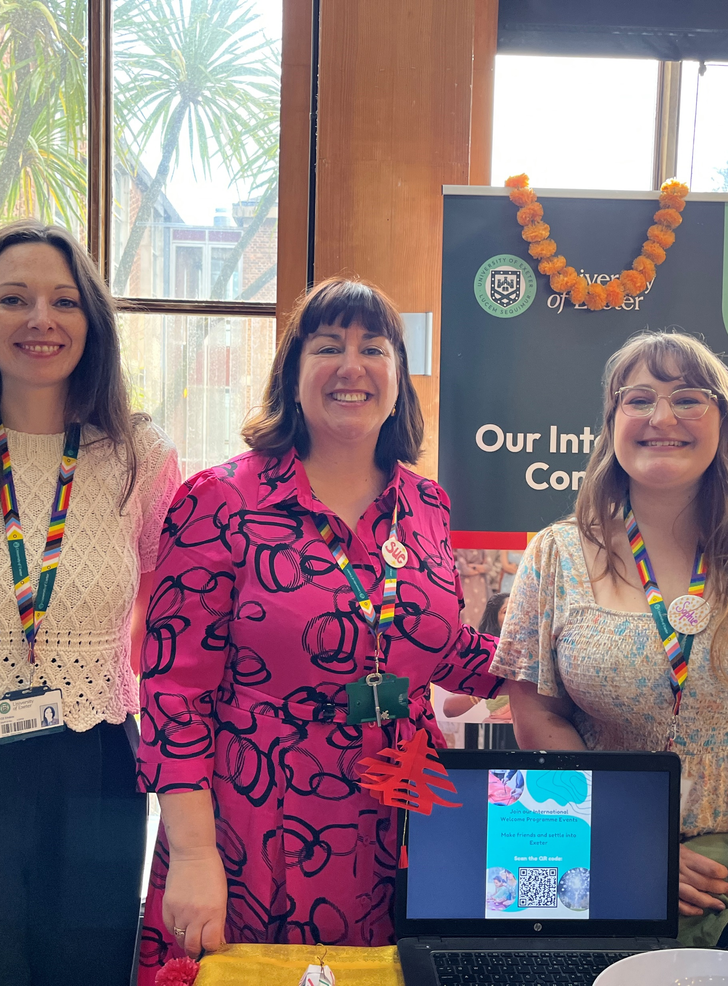
Meet International Student Experience Team
Sue O’Hara
Sophie Meadows
Jimena Rubio Juncal
Over 20 years experience welcoming and working with international students at Exeter.

Slide 3

Meet the International Student Support Team
Advising students before, during
and after their studies
Trained immigration advisers
Experts on the Student visa route
Free service!

Slide 4
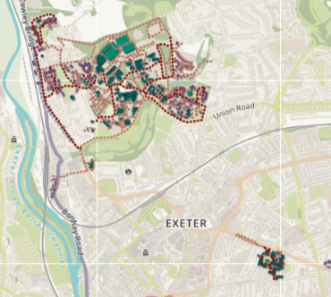
The Exeter campuses
Streatham and St Lukes campuses are easy to travel to by foot and public transport.
Streatham – St Lukes campus: 20-minute bus route (UNI) between both campuses (£2 bus fare) or a 30-minute walk.
Both routes go through town- easy links to more transport (bus station) and shops.
There are many walk routes and bus options available in the city for you to travel to and from campus that you can access from your phone and Stagecoach bus app.
If you think you’ll be using public buses regularly it is cheaper to buy a discounted Termrider ticket.

Slide 5
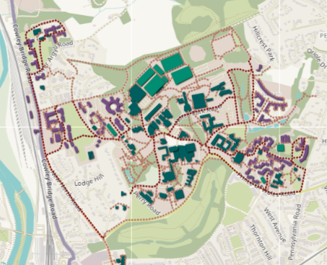
Map of Streatham campus
What’s on campus:
Library and Study Spaces
Shops: Blackwells (bookshop), Market Place
Food outlets and eating areas
Lecture buildings
Bus stops for UNI bus
Accommodation blocks
Health Centres
Gym/ Sports Hall/ Swimming Pool
Exeter Student’s Guild
INTO (English Language Support)
Food Market (on Fridays)
Multifaith Chaplaincy and rooms for prayer
Venues for non-academia: Exeter Northcott Theatre, RAM bar, Lemon Grove, Great Hall.
Family Centre (Owlets)
You can use the interactive maps to explore campus here

Slide 6
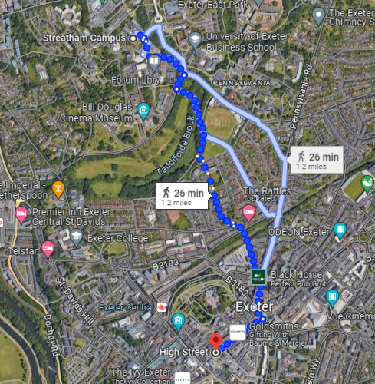
Streatham campus in the city
How long to travel into city (High Street) from Streatham: approx. 26-minutes walking, UNI bus £2 per journey (15-minutes).
There are plenty of bus options on the University website.
Free shuttle bus linking campuses to St Davids train station.
For evening travel: NIGHT bus Streatham campus and city centre (Wed, Fri and Sat
Term time only: 9pm to 4am)
Watch a student POV travelling from Streatham campus to town

Slide 7
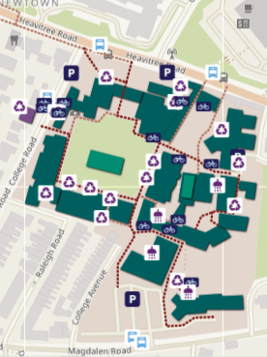
Map of St Lukes campus
What’s on campus:
Library and Study Spaces
Lecture rooms
Food outlet: Cross Keys
UNI bus stops
Sports Centre and Swimming Pool
Multifaith Chaplaincy
Exeter Student’s Guild
Close by: Accommodation blocks, Waitrose supermarket, shops along Magdalen Road, Health Centres and RD&E Hospital
You can use the interactive maps to explore campus here

Slide 8
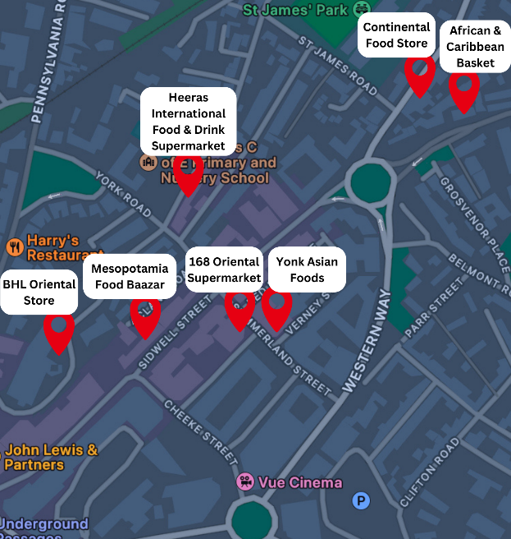





Shopping in the city – Grocery shopping
There are many small supermarkets in the city centre where you can do a weekly shop, e.g. Tesco, Sainsbury’s.
Bigger and cheaper supermarkets require a car/bus, e.g. Aldi, Lidl, (bigger) Tesco, Morrisons. It can be cheaper if you do bigger and less frequent shops. Consider ordering a delivery service with your fellow tenants. For cheaper transport to the supermarket, consider sharing a taxi with your flatmates.
Supermarkets normally open until 10pm (with some exceptions for smaller ones), but they close at 5pm or earlier on Sundays.
There are varied international shops in the city centre. These follow their own opening schedules.
Some international stores in Exeter city centre.
Tesco Clubcard offers discounts.
Get the Nectar Card for discounts.

Slide 9
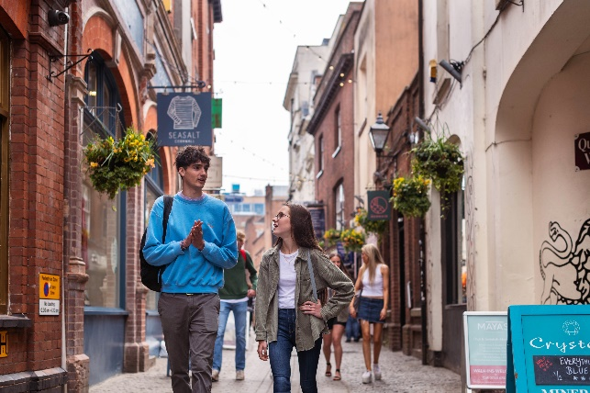
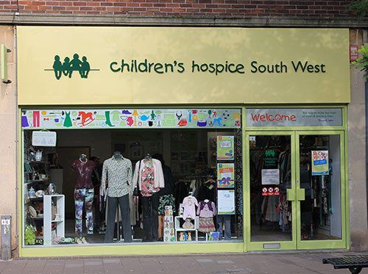


Shopping in the city – Clothes and homeware
If you’ll be staying in University accommodation, check what is included before buying homeware.
          Wilko is in the city centre has a lot of homeware options
          IKEA is only a bus ride away (Bus J or I from the city centre) and offers plenty of cheap options. Join our planned trip to IKEA on Thursday of Welcome Week.
                For cheap clothes and other items, check out Exeter’s many charity shops (British Heart Foundation, Children’s hospice, Cancer Research UK and more).
                Princesshay is Exeter’s main shopping precinct with high street stores.
                Fore Street and Gandy Street hold many gems if you want to explore independent shops.

Slide 10
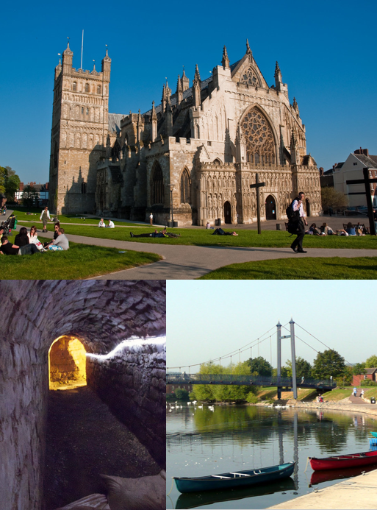
Places of interest in the city
Exeter Cathedral: 25 minutes walking from Streatham campus; 18 minutes from St Luke’s campus. Free to visit for worship or if you get a Residents’ card, which you can get if your postcode starts with EX1-EX4.
Exeter Quay: 35 minutes walking from Streatham campus; 18 minutes from St Luke’s campus. Beautiful in a sunny day.
Underground passages: 23 minutes walking from Streatham campus; 16 minutes from St Luke’s campus. £6 for students.
Red Coat tours will walk you through the history of Exeter for free.

Slide 11

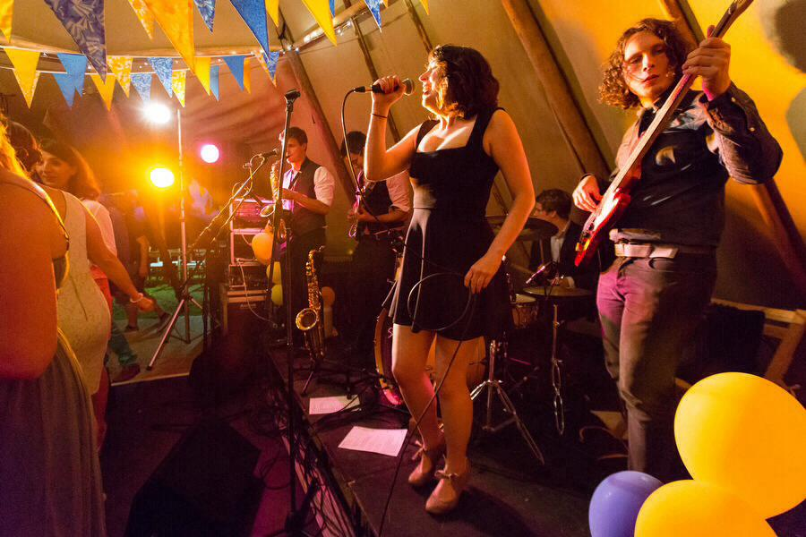
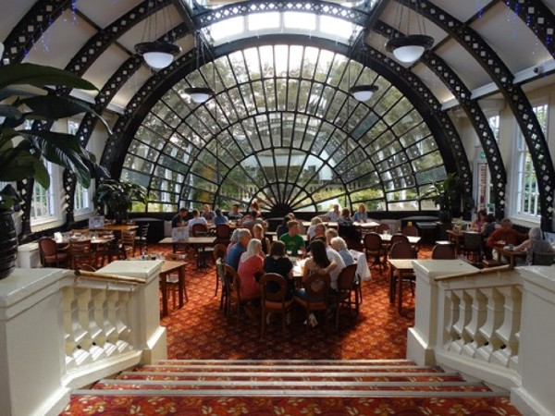
Nightlife
Exeter has many different types of venues for evening life: bars, music venues, comedy clubs, theatre, etc. Below we’ve listed a few student favourites.
Pubs and bars: The Ship Inn, The Turks Head, Double Locks (by the river). The most popular among students are The Ram bar (on campus) and The Imperial.
Live music: The Old Firehouse, Lemon Grove, Exeter Phoenix and others host concerts and events.
Clubs: popular venues include Timepiece, Fever & Boutique, Cavern, etc.
Most venues should have the logos (above) somewhere. It means that if you’re feeling uncomfortable or need help on a night out there are a number of different ways to get support. Our Community Guide has more information.

Slide 12
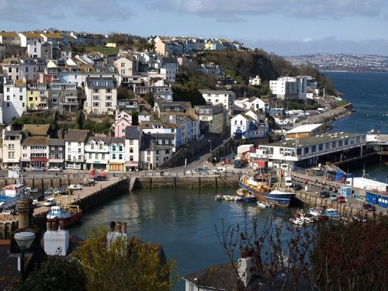

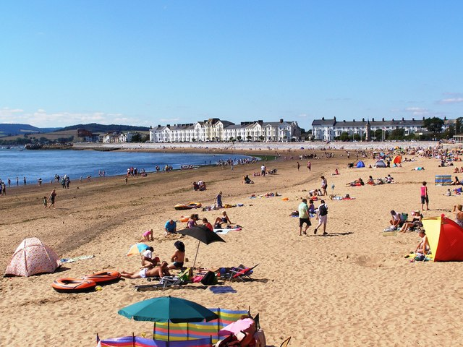
Local places to visit
Nearby towns, e.g. Totnes, Topsham, Brixham, Torquay…
Dartmoor: train St David’s – Okehampton for £5.80 with a railcard.
Beaches, e.g. Exmouth, Teignmouth, Dawlish Warren…
Check our website for recommendations from students. Click ‘Day trip suggestions from Intercultural Café’.

