Slide 1
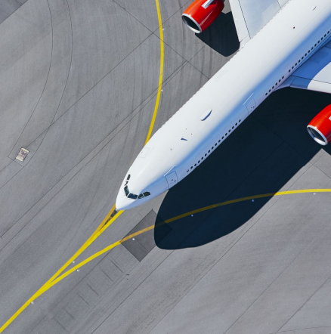
Getting from Dublin Airport to the University of Exeter
(Streatham Campus)

Slide 2
You will need to fly into either Exeter or Bristol Airport

Slide 3
Flying into Exeter Airport
There are limited flights from Dublin to Exeter Airport, most of which include at least one change over.
It is advisable to book a flight as early as possible.
Exeter airport is approximately 45 minutes from Exeter campuses
Catch Bus 4A from outside the airport to Exeter St David’s station and then find a taxi outside the station to take you to Streatham campus.
It might take you longer than normal to get through any airport checks, so make sure you leave plenty of time between connecting flights!
Dublin Airport
Catch a flight from Dublin to Exeter
Catch bus 4A to
Exeter St David’s train station
Get a taxi from the train station to
Streatham Campus
You’ve arrived!

Slide 4
Flying into Bristol Airport
There are a few direct flights each day from Dublin to Bristol operated by different airlines. The journey time is 1 hour 20 minutes.
It is advisable to book a flight as early as possible.
Bristol airport is approximately 2 hours from Exeter campuses.
Catch the A2 bus (Airport Flyer Express) from outside the airport to Bristol Temple Meads and then the train to Exeter St David’s train station.
Dublin Airport
Catch a flight from Dublin to Bristol
Catch the A2 (Airport Flyer Express) bus to
Bristol Temple Meads
Board train to
Exeter St David’s station
Get a taxi from the train station to
Streatham Campus
You’ve arrived!

Slide 5
We hope you have a safe journey and we look forward to welcoming you to the University of Exeter

