Slide 1

Getting from Stansted Airport to the University of Exeter
(Streatham Campus)

Slide 2


There’s two ways to continue your journey
Rail
Bus
OR

Slide 3
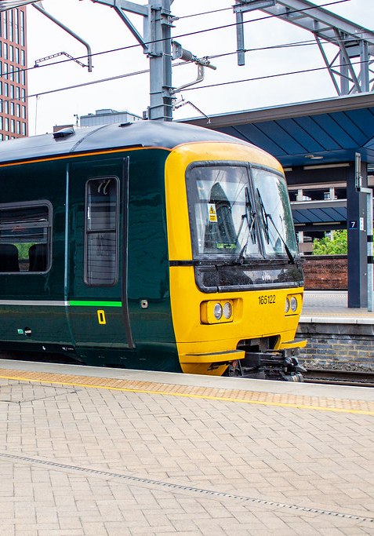
Rail

Slide 4


Travelling By Train
When you arrive at Stansted Airport you will need to look out for the following sign:
Stansted Airport train station is less than a 5-minute walk from the departure lounge and trains run from 05.30am to 12.30am (Mon-Fri) every 15 minutes.
Board the Stansted Express train to London Liverpool Street. This journey will take 48 minutes.
From Liverpool Street you will need to find the Underground sign:
Board either the Hammersmith & City line or the Circle line to London Paddington station. This journey will take 20 minutes. You can pay by card at the underground gates.
Board a train at London Paddington station to Exeter St. David’s train station. Trains run every couple of hours with no changes and roughly take around 2-3 hours.
It is advisable to pre-book your train ticket from Paddington to Exeter due to price and availability. Here is the website for booking your train tickets online: https://www.thetrainline.com

Slide 5
Handy Flow Chart!
Stansted Airport
Locate the train station and board the Stansted Express to London Liverpool Street
From outside Exeter St David’s get a taxi to
Streatham Campus
You’ve arrived!
Board the Underground Hammersmith & City line or Circle line to London Paddington
Board the train from London Paddington to Exeter St David’s station

Slide 6
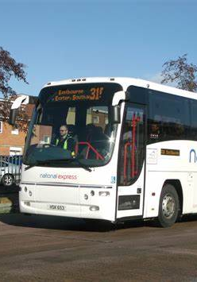
Bus

Slide 7

Travelling By Bus
You can catch the National Express bus from Stansted airport. The bus station is a two-minute walk from the terminal.
The National Express bus takes roughly 6.5 hours to reach Exeter. There is a change of bus at Heathrow Airport.
Tickets must be bought in advance from this website: https://www.nationalexpress.com/en
Stansted Airport
A 2-minute walk to the bus station. Board the National Express to Exeter Bampfylde Street
Arrive at Exeter Bampfylde Street and call Apple Taxis (01392 666666) to
Streatham Campus
Change bus at
Heathrow Airport
You’ve arrived!

Slide 8
We hope you have a safe journey and we look forward to welcoming you to the University of Exeter

